Slide 1
Introduction to Recommender Systems
Dhruv Sakalley

Slide 2
Objective
Conceptualize
Get familiar with the keywords and key concepts in the space of recommender system
Create
Get introduced to some very easy ways to start building recommender systems
Know
Know the names of the common algorithms
Celebrate
Establish and understanding that implementing recommender systems is easy but optimizing them needs an understanding of the inner workings

Slide 3

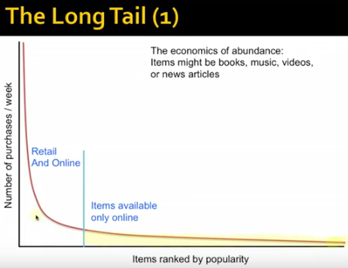

Why?

Slide 4

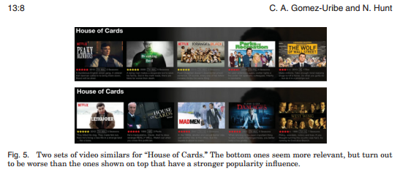
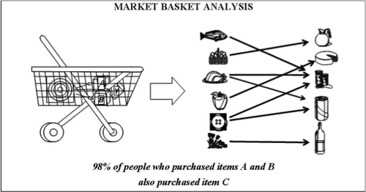

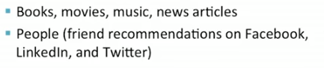
Where?
netflix recommender system

Slide 5
Concepts
Information search and retrieval
Active/passive
Ranking
Similarity*
Relevance
Loss function/ reward function
Learning
Evaluation

Slide 6
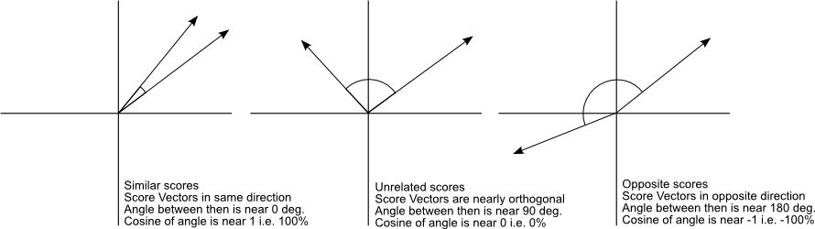
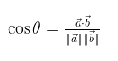
Similarity
Cosine
cosine_similarity(row1,matrix)
array([[ 1. , 0.36651513, 0.52305744, 0.13448867]])
Other popular measures measures like Pearson’s Correlation, Jaccard (set-wise-similarity), linear kernels (TF-IDF)

Slide 7
Concrete Concepts
Utility/ Affinity Matrix *
Graphs G(V,E)
Bipartite Graphs *
Matrix Factorization & Matrix Completion*
Singular Value Decomposition
ALS
K Nearest Neighbors

Slide 8
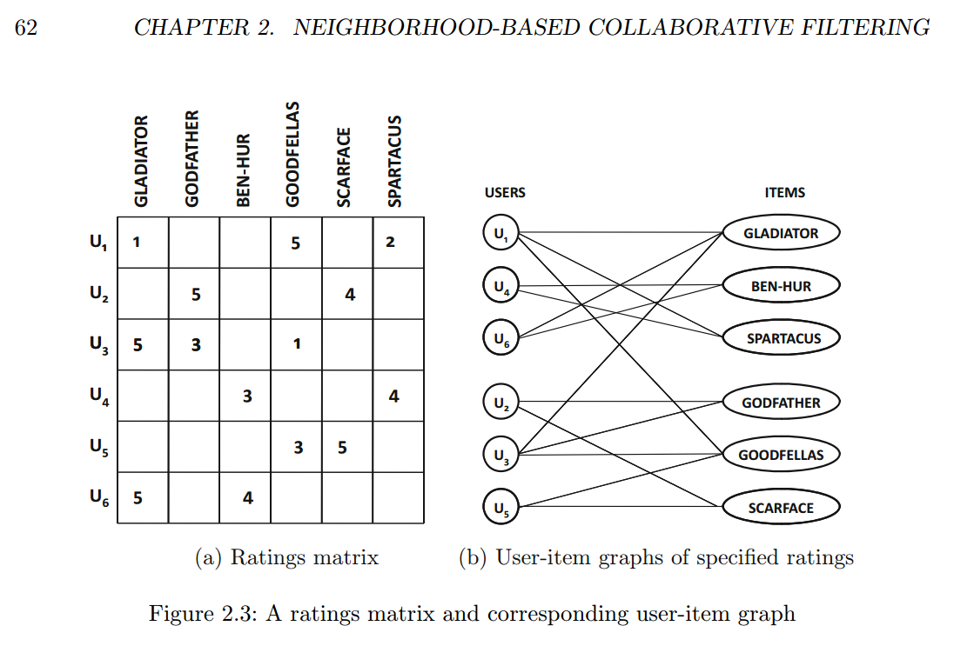
Affinity Matrix & Undirected Bipartite Graphs

Slide 9
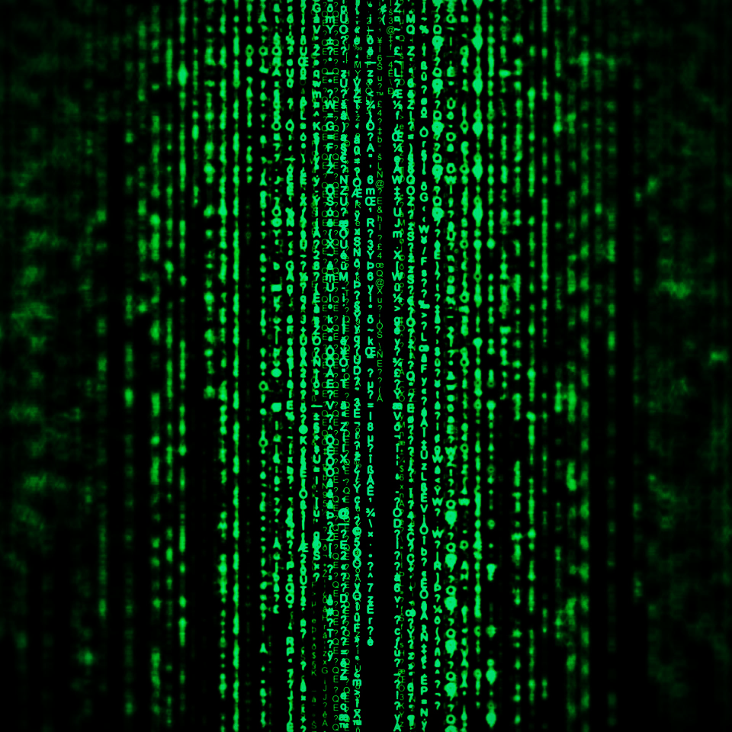
Matrix Factorization & Matrix Completion
6 = 2 x 3
Decomposing
sparse user-item interactions matrix => set of K dimensional vectors one for each item and user in the dataset.
Recommendation problem as a matrix completion/reconstruction problem
Latent factor vectors are used to fill the missing entries.

Slide 10


Sparse
Factorized
Dense

Slide 11
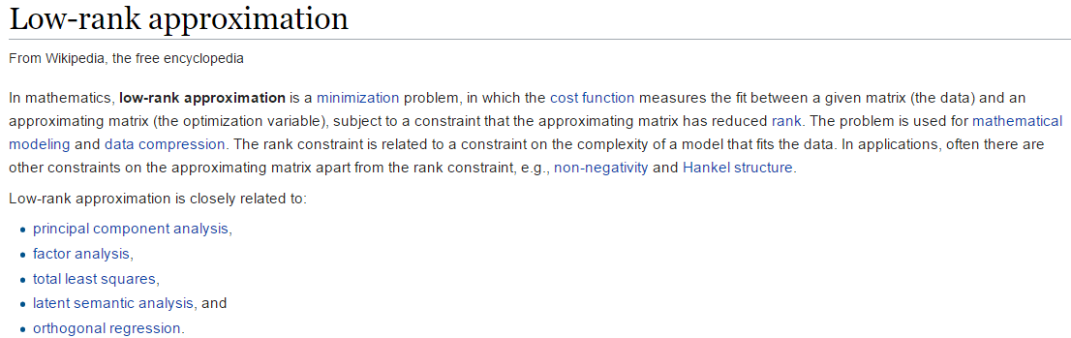
Can I say Machine Learning!

Slide 12
Types
Content-based
Feature Similarity
Collaborative Filtering : Patty Maes (MIT) ~late 1990s
Neighborhood based (aka Memory based)
Model based
Deep learning and probabilistic graphical model approaches.***
word2vec
Note: Domain specific applications e.g. social network, time-variant etc.
Hybrid Systems (Content + Collaborative)

Slide 13
Neighborhood Methods (Memory based)
Similarity becomes very important
User-user similarity
Item-Item similarity
Clustering
Near Neighbor Regression
Dimensionality Reduction
Direct matrix factorization (SVD)
Advanced – Graph models for neighborhood based methods

Slide 14
Model-Based Collaborative Filtering
Decision and Regression trees
Rule-based (association-rules)
Naïve Bayes
Neural networks (black-box) arbitrary classification
Latent factor model
Alternating Least Squares (ALS) and Coordinate Descent
Unconstrained matrix factorization
Non-negative matrix factorization (NMF)
Stochastic Gradient Descent

Slide 15

Popular in Latent Factor Models
ALS
where Xk and Yk are low rank. "Approximate" means minimizing some squared-error difference with the input A. Fix one and calculate other, parallelizable, but X and Y are not always orthonormal.
SVD
Produces orthonormal vectors but is computationally expensive.
Fixed solution = high bias towards the training data.
Optimal low rank approximation : Frobenius Norm

Slide 16
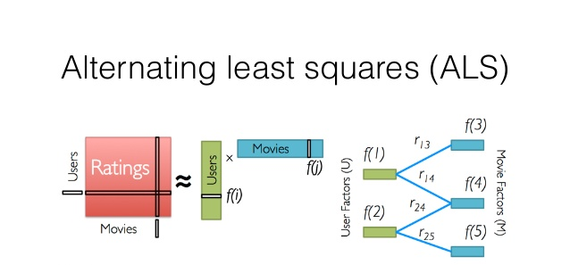

Slide 17
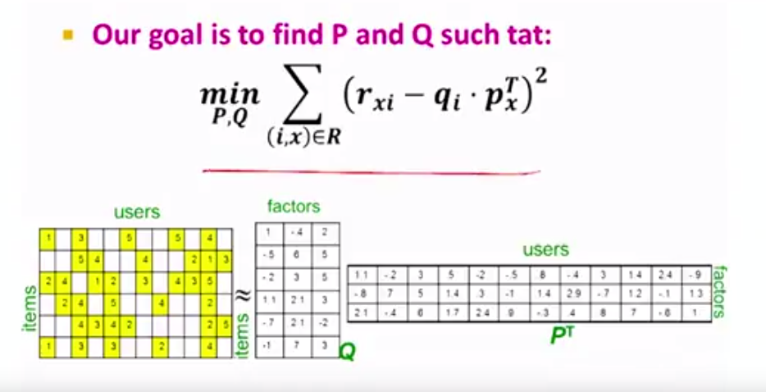

Slide 18
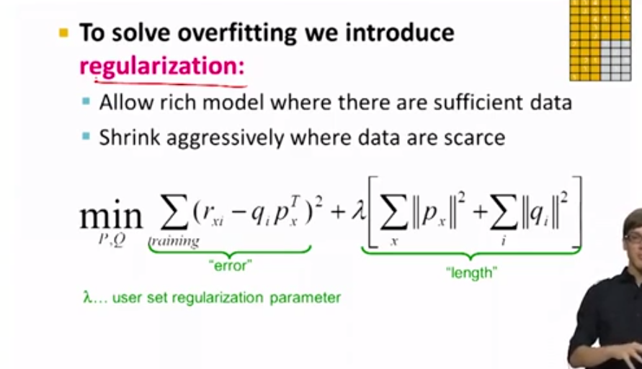
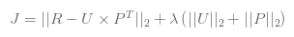

Slide 19
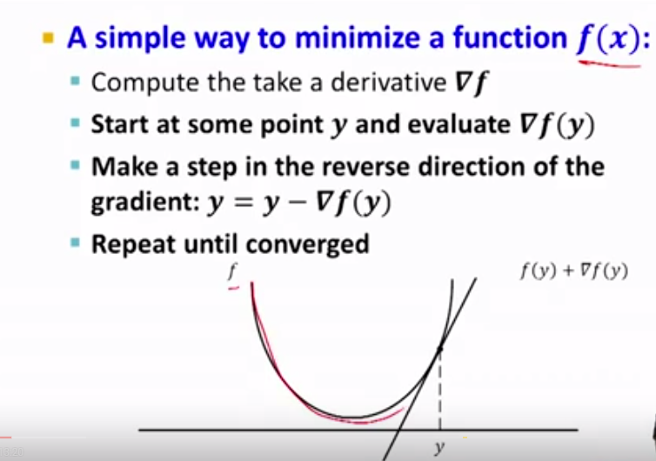
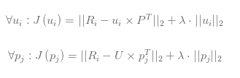
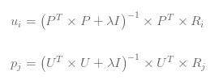

Slide 20
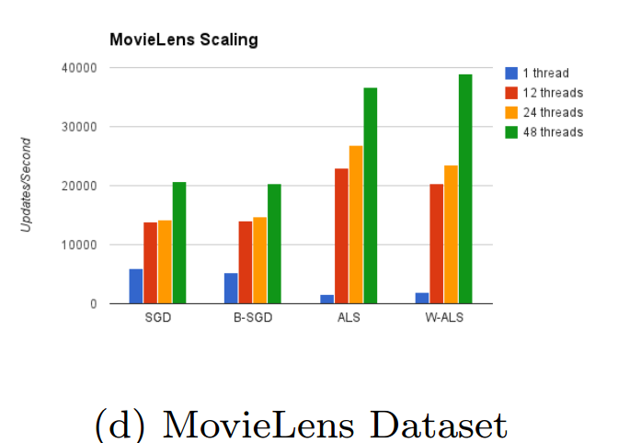
Recommender: An Analysis of Collaborative Filtering Techniques Christopher R. Aberger
http://cs229.stanford.edu/proj2014/Christopher%20Aberger,%20Recommender.pdf

Slide 21
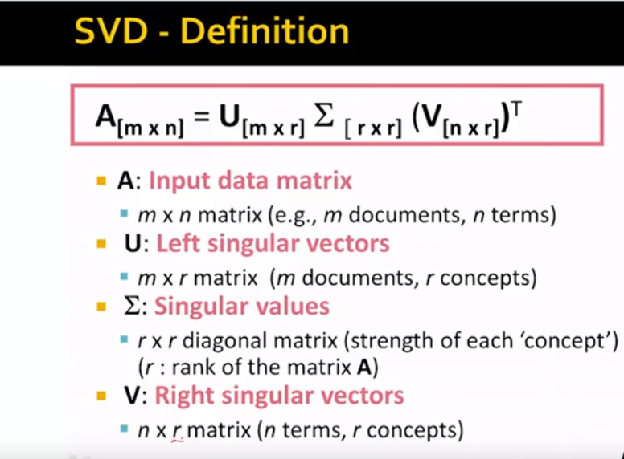
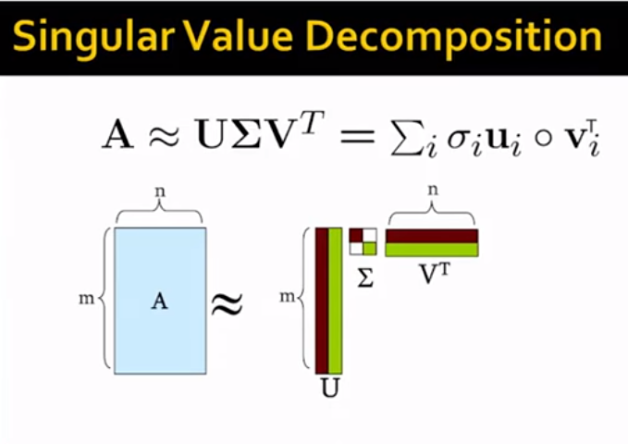

Slide 22
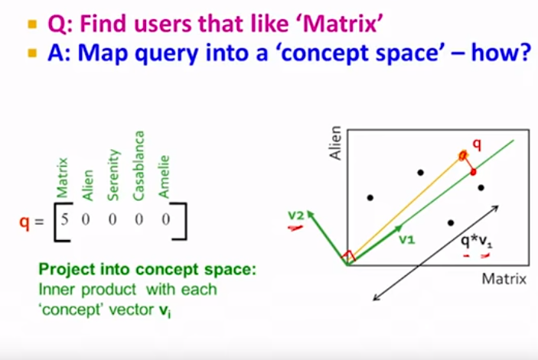

Slide 23
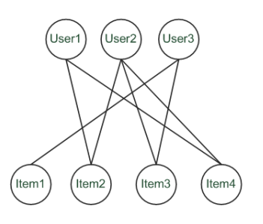
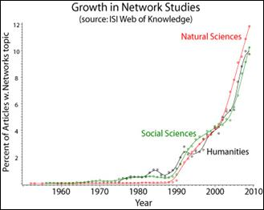

Slide 24
Evaluation
Root-mean-square error (RMSE)
Mean absolute error (MAE)
Coverage: percentage of pairs for which recommendations can be made
Predict top k
Binary (good/bad): ROC curves/ AUC with labeled data (supervised evaluation)

Slide 25
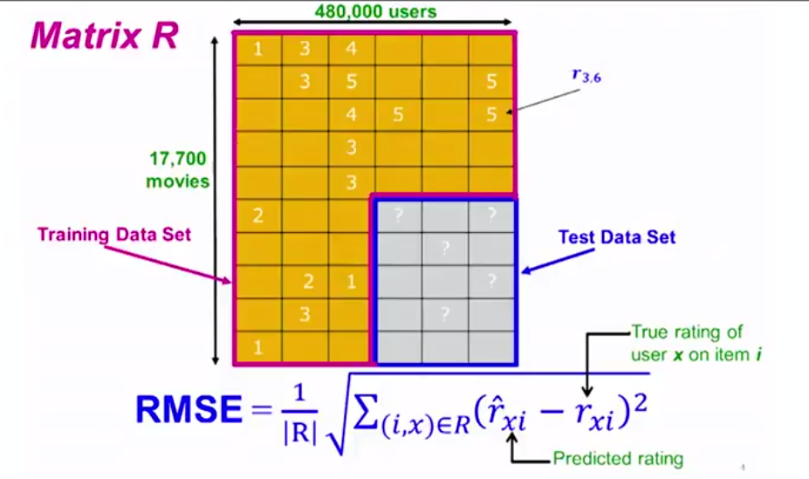

Slide 26
Gotchas!
Bias, overfitting and regularization
Computation complexity, scale and operationalization of models
Time variance
Echo chambers

Slide 27
Recommended Resources
Book: http://www.springer.com/us/book/9783319296579
Stanford U Videos: https://www.youtube.com/watch?v=IlqnNWuqToo
Andrew NG Coursera Recommender System Videos:
https://www.youtube.com/watch?v=RcOUXmCAssg
Libraries: Demo:
LightFM,
https://www.youtube.com/watch?v=EgE0DUrYmo8
https://github.com/lyst/lightfm
Surprise http://surpriselib.com/
Other Libraries and Packages: https://github.com/grahamjenson/list_of_recommender_systems

Slide 28
Thank you!
Demo and questions
Dhruv.Sakalley@gmail.com
@sakalleydhruv

